Slide 1
IT-106: Introduction to IT Problem Solving Using Computer Programming
Module 1b
Introduction to Java / More on Algorithms and Pseudocode

Slide 2
In This Lecture
Components of the Java Environment
Your First Java Program
Problem Solving with Algorithms and Pseudocode

Slide 3
Questions?

Slide 4
Components of the Java Environment

Slide 5
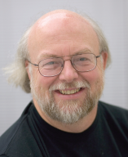
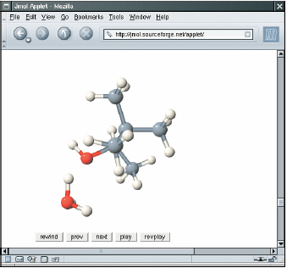
The Java Language
In 1991, James Gosling of Sun Microsystems designed what would become the Java programming language
In 2010, Sun was bought acquired by Oracle
Platform independent
Can run on almost any machine
Java was originally designed for programming consumer devices, but it was first successfully used to write Internet applets

Slide 6
Java History
Original design goals
Safety
Can be run inside a browser and will not attack your computer
Portable
Can run on many Operating Systems
Windows, Mac, Linux, etc.
Platform independent
Java programs can be distributed as instructions using a "virtual machine" on almost any operating system
The iPhone is a notable exception

Slide 7
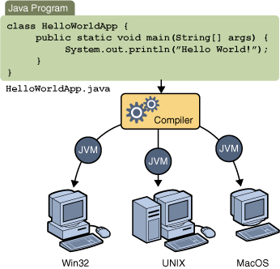
Java Virtual Machine (JVM)
Java code starts as source code (human-readable)
A compiler converts it into machine readable code (byte code)
Any JVM can then run the code, which is in a .class file

Slide 8
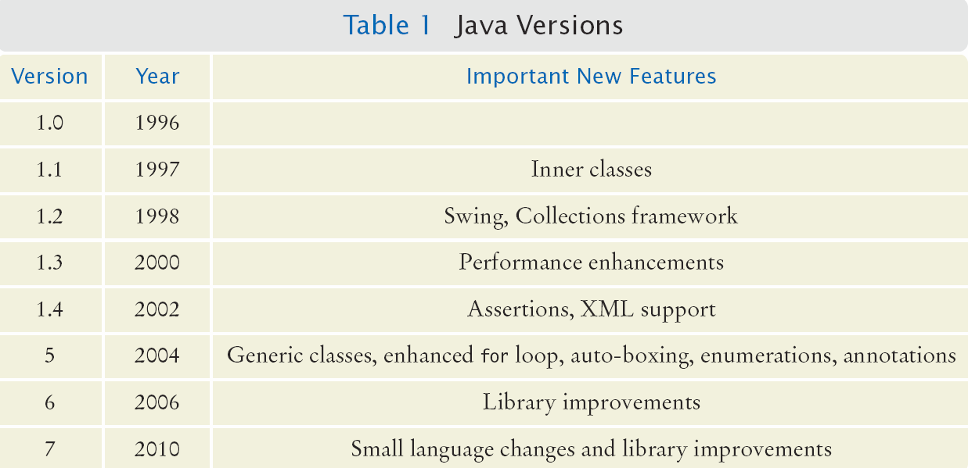
Java Timeline

Slide 9
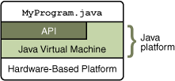
The Java Platform
The Java Platform consists of two parts:
Java Virtual Machine (JVM)
Java Application Programming Interface (API)
A huge collection of handy software packages that programmers can use
Graphics, user interface, networking, sound, database, math, etc.
Helps programmers not have to reinvent the wheel

Slide 10
The Java Standard Development Kit (SDK)
To be able to create Java programs, you must install the Java Software Development Kit (SDK)
Download: http://www.oracle.com/technetwork/java/javase/downloads/index.html
Common location after installation will be:
C:\Program Files\Java\jdk_____ (a set of numbers)
The set of numbers will vary with the release
The SDK includes programs such as:
java.exe (executes Java applications)
javac.exe (Java compiler)
javadoc.exe (Javadoc generator)

Slide 11
Programming Environment
There are many free programming tools available for Java
I recommend jGrasp (http://www.jgrasp.org/) because it is free and easy, but you can use anything you want
Components of an Integrated Development Environment (IDE)
Source code editor helps programming by:
Listing line numbers of code
Color lines of code
Helps with indenting for readability
Output window
Debugger

Slide 12
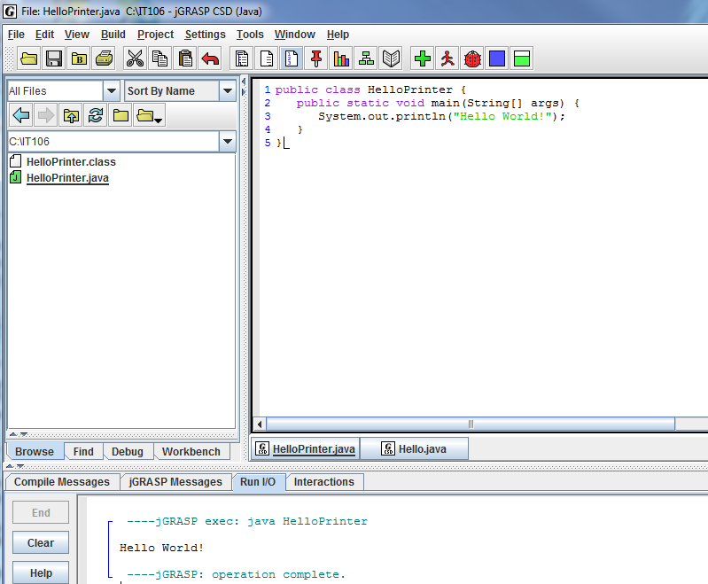
jGrasp: An Example IDE
Editor
Many IDEs are designed specifically for Java programming
Output

Slide 13

Hello World: Your First Java Program
Below is a traditional "Hello World" program in Java
The name of the file is HelloPrinter.java
Typing the program into your IDE would be good practice!
Be careful of spelling
JaVa iS CaSe SeNsItiVe
Java uses special characters, such as curly braces {} and parentheses ()

Slide 14
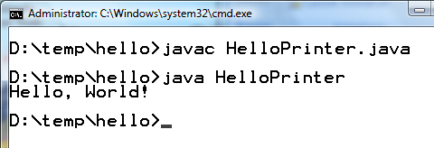
Text Editor Programming
You do not need to have an IDE
You can use a simple text editor, such as Notepad to write your source code
Once saved as HelloPrinter.java, you can use a command prompt to:
Compile the program
Execute the program
Compile
Output
Execute

Slide 15
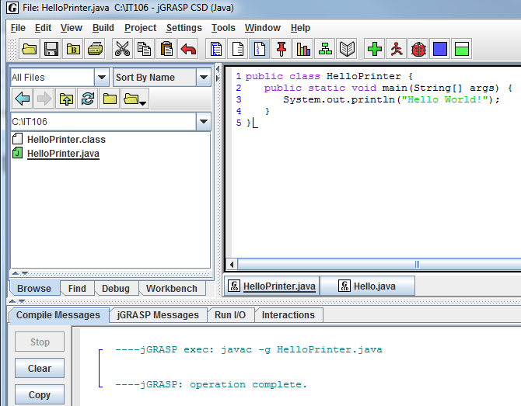
jGrasp: Compiling a Program
Click the "+" icon to compile the program
Result

Slide 16
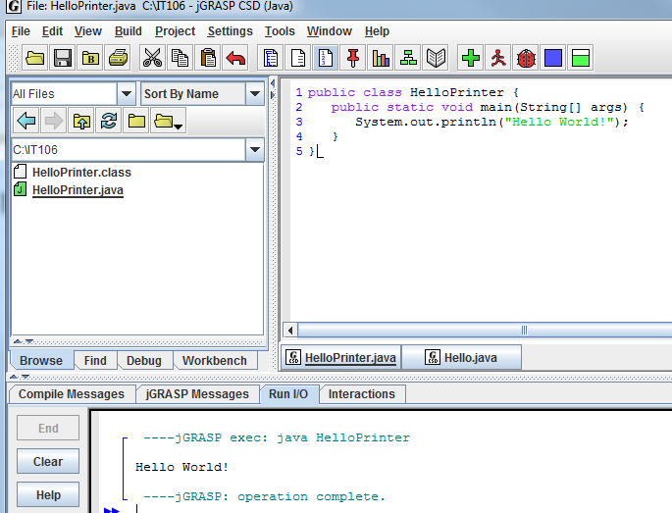
jGrasp: Running a Program
Click the "Running Man" icon to execute the program
Output

Slide 17
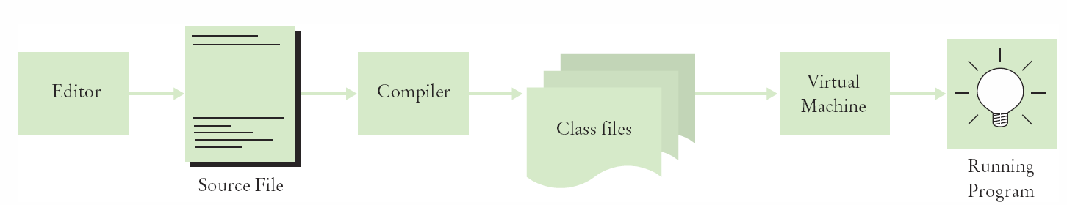
Source Code to Running Program
The compiler generates .class files for each .java file, which contains machine-readable instructions for the Java Virtual Machine (JVM)
.class files contain 'byte code' that are machine readable and uneditable
C:\IT106\>Type HelloPrinter.class
╩■║╛ 2 ↔ ♠ ☼ ► ↕ ‼ ¶ § ▬☺ ♠<init>☺ ♥()V☺ ♦Code☺ ☼LineNumberTable☺ ♦main▬([Ljava/lang/String;)V☺
Hello, World! elloPrinter.java♀ ↨♀ ↑ ↓☺

Slide 18
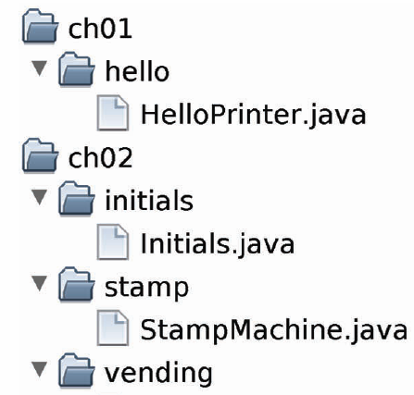
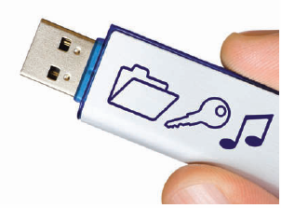
Organize Your Work
Source code is stored in .java files
Create one folder per program
A program can have many .java files
Be sure you know where the IDE stores your files
"**IT Happens"
Backup your work!
Backup your work to a Flash Drive, external hard drive, or network drive that is backed up nightly.

Slide 19
Your First Java Program

Slide 20
Analyzing Your First Java Program
Line 1: Declares a class called HelloPrinter
Java programs are constructed with one or more classes
Line 2: Declares a method called main
Every Java program has exactly one main method
The main method is the entry point where the program starts
Line 5: Method System.out.println outputs "Hello World!"
System.out is part of the Java API
All statements must end with a semi-colon

Slide 21
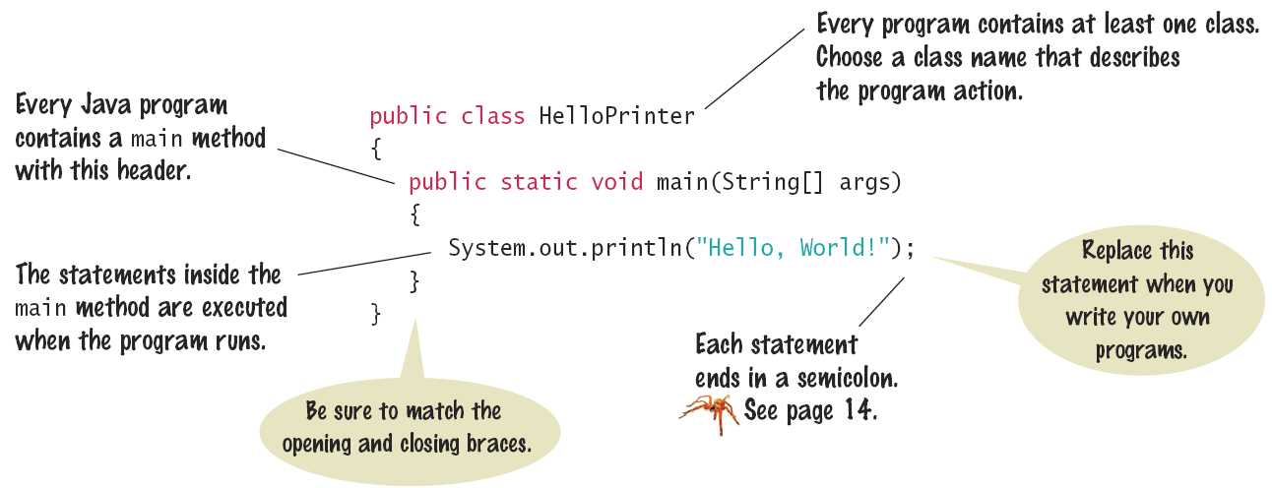
Syntax: The Java Program
Every Java program has the same basic layout
Add your code inside the main method

Slide 22
Calling Java Library Methods
Note the Line:
It shows how to "call" a method from the Java API (System.out.println)
Code that somebody else wrote for you
Notice the dots (periods)
Parentheses surround the arguments that you "pass" to a method
We are passing a String "Hello World"
Using double quotes denotes a string
You can also print numerical values
Example: System.out.println(3 + 4);
Note that numbers are not quoted

Slide 23
More on the println Method
The println method prints a string or a number and then starts a new line
System.out.println("Hello");
System.out.println("World");
A similar function that does not print a new line is print
System.out.print("00");
System.out.println(3+4);
Hello
World!
007

Slide 24
Errors
Remember, there are three categories of errors
Syntax Errors
Examples
Misspelling, capitalization, punctuation
Ordering of statements, matching of braces/parentheses
No .class file is generated by the compiler
Correct the first error listed, then compile again
Logic Errors
Program runs, but produces unintended results
Check your algorithm for the logic you have included
Runtime Errors
Causes the program to crash, such as divide by zero
Check your algorithm to make sure you have handled all cases

Slide 25
Syntax Errors
What happens if you:
misspell a word System.ou.println
don't capitalize a word system.out.println
leave out a word System.println
forget a semicolon Remove ; at the end of line 3
don't match a curly brace Remove line 5
Try each of these to see what happens when you try to compile to get practice in dealing with compiler error messages

Slide 26
Logic Errors
What happens if you:
misspell the output ("Hello Word!")
forget to output Remove line 3
In these cases, the program will compile and run
The output may not be as expected

Slide 27
Runtime Errors
What happens if you:
Divide by zero System.out.println(1/0)
In these cases, the program will compile, but when it runs, it will crash

Slide 28
Questions?

Slide 29
Problem Solving with Algorithms and Pseudocode

Slide 30
Algorithms
Algorithms are simply plans or blueprints
Describes the steps that can be used to solve a specific problem
You already know quite a few
Calculate the area of a circle
Find the length of the hypotenuse of a triangle
Some problems are more complex and require more steps
Calculate the shipping costs of a shopping cart order
Calculate the trajectory of a missile

Slide 31
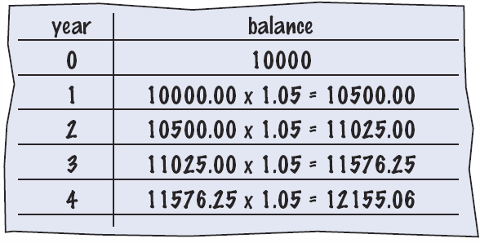
Creating an Algorithm from a Problem
Given the problem:
"You put $10,000 into a bank account that earns 5% interest per year. How many years does it take for the account balance to be double the original?
How could it be solved?
Manual method
Make a table
Add lines until done
Use a spreadsheet
Write a formula, per line, based on the manual method

Slide 32
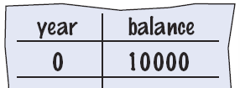
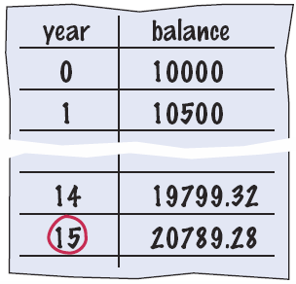
Creating an Algorithm from a Problem (Cont'd)
Given the problem:
"You put $10,000 into a bank account that earns 5% interest per year. How many years does it take for the account balance to be double the original?
Break it into steps
Start with a year value of 0 and a balance of $10,000
Repeat the following while the balance is less than $20,000
Add 1 year to the year value
Multiply the balance by 1.05 (5% increase)
Report the final year value as the answer

Slide 33
Converting the Algorithm to Pseudocode
Pseudocode
An informal description of the sequence of steps to solve a problem
Modified Steps
Set the year value to 0
Set the balance to $10,000
While the balance is less than $20,000
Add 1 to the year value
Multiply the balance by 1.05
Print the final year value as the answer
This can be translated to Java fairly easily

Slide 34
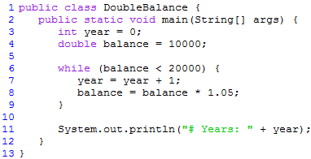
Resulting Java Program
Pseudocode
An informal description of the sequence of steps to solve a problem
Modified Steps
Set the year value to 0
Set the balance to $10,000
While the balance is less than $20,000
Add 1 to the year value
Multiply the balance by 1.05
Print the final year value as the answer
This can be translated to Java fairly easily

Slide 35
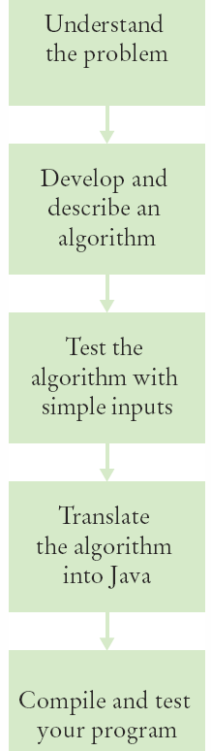
Algorithm Review
An algorithm describes a sequence of steps that is:
Unambiguous
Does not require assumptions
Uses precise instructions
Executable
Can be carried out in practice
Terminating
Will eventually come to an end

Slide 36
Questions?

